Slide 1






⥫
Optimizing Maintenance and Repair Techniques for Thruster ROVs: Ensuring Reliability
and Performance

Slide 2
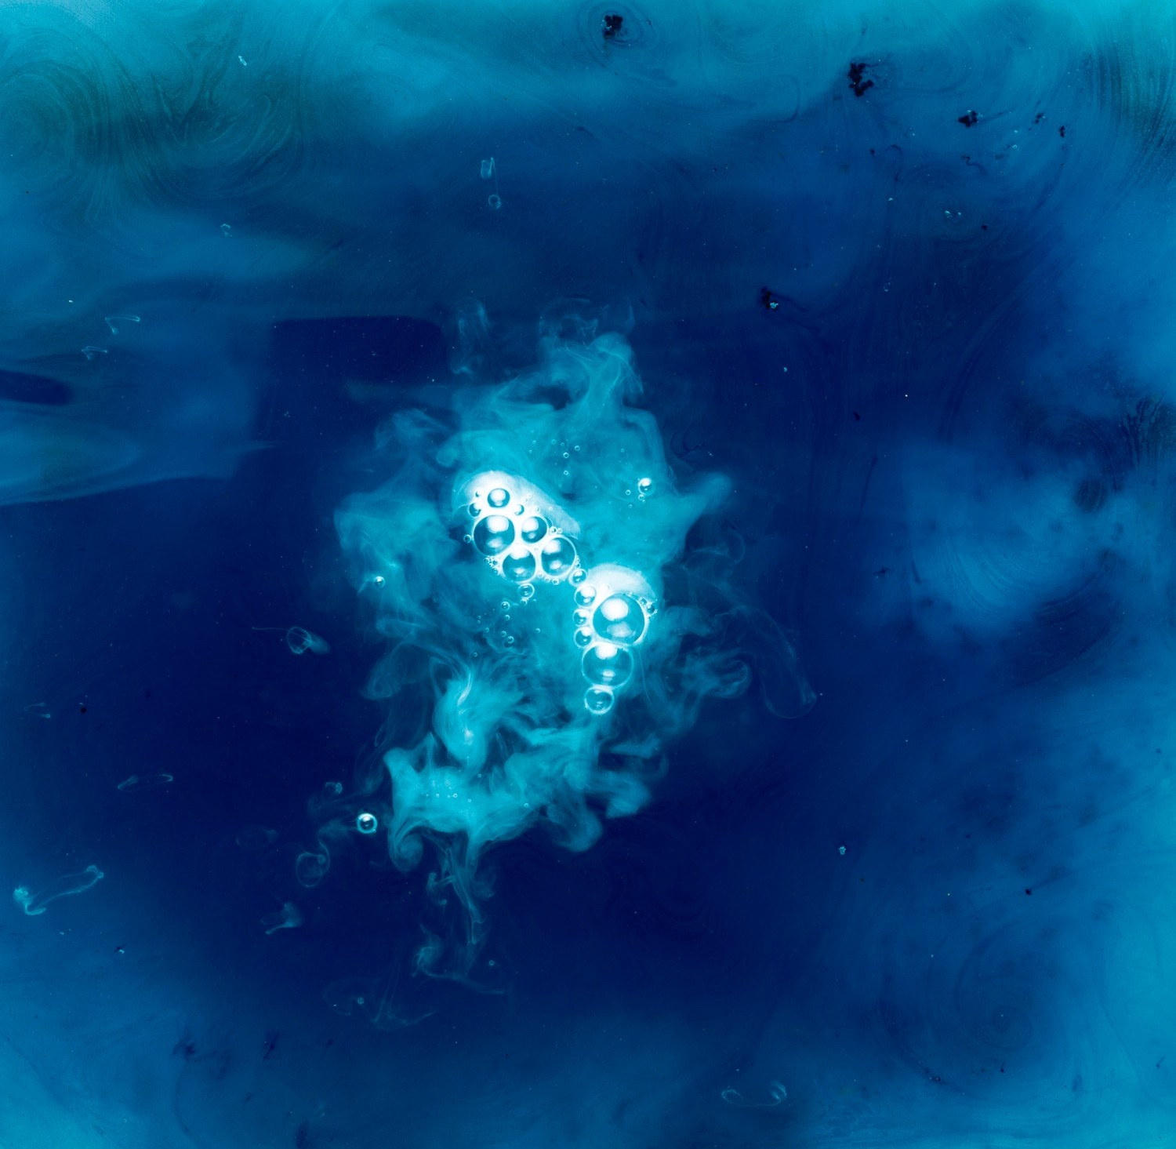




Introduction to ROV Maintenance
In this presentation, we will explore and for . Ensuring and
in underwater operations. We aim to provide insights into effective
is crucial
strategies that enhance the longevity and efficiency of these vital tools.

Slide 3






Understanding Thruster ROVs
are remotely operated vehicles equipped with thrusters for mobility in underwater environments. Their design allows for , making them essential for various tasks, including exploration, inspection, and maintenance. Understanding their components is key to effective maintenance.

Slide 4
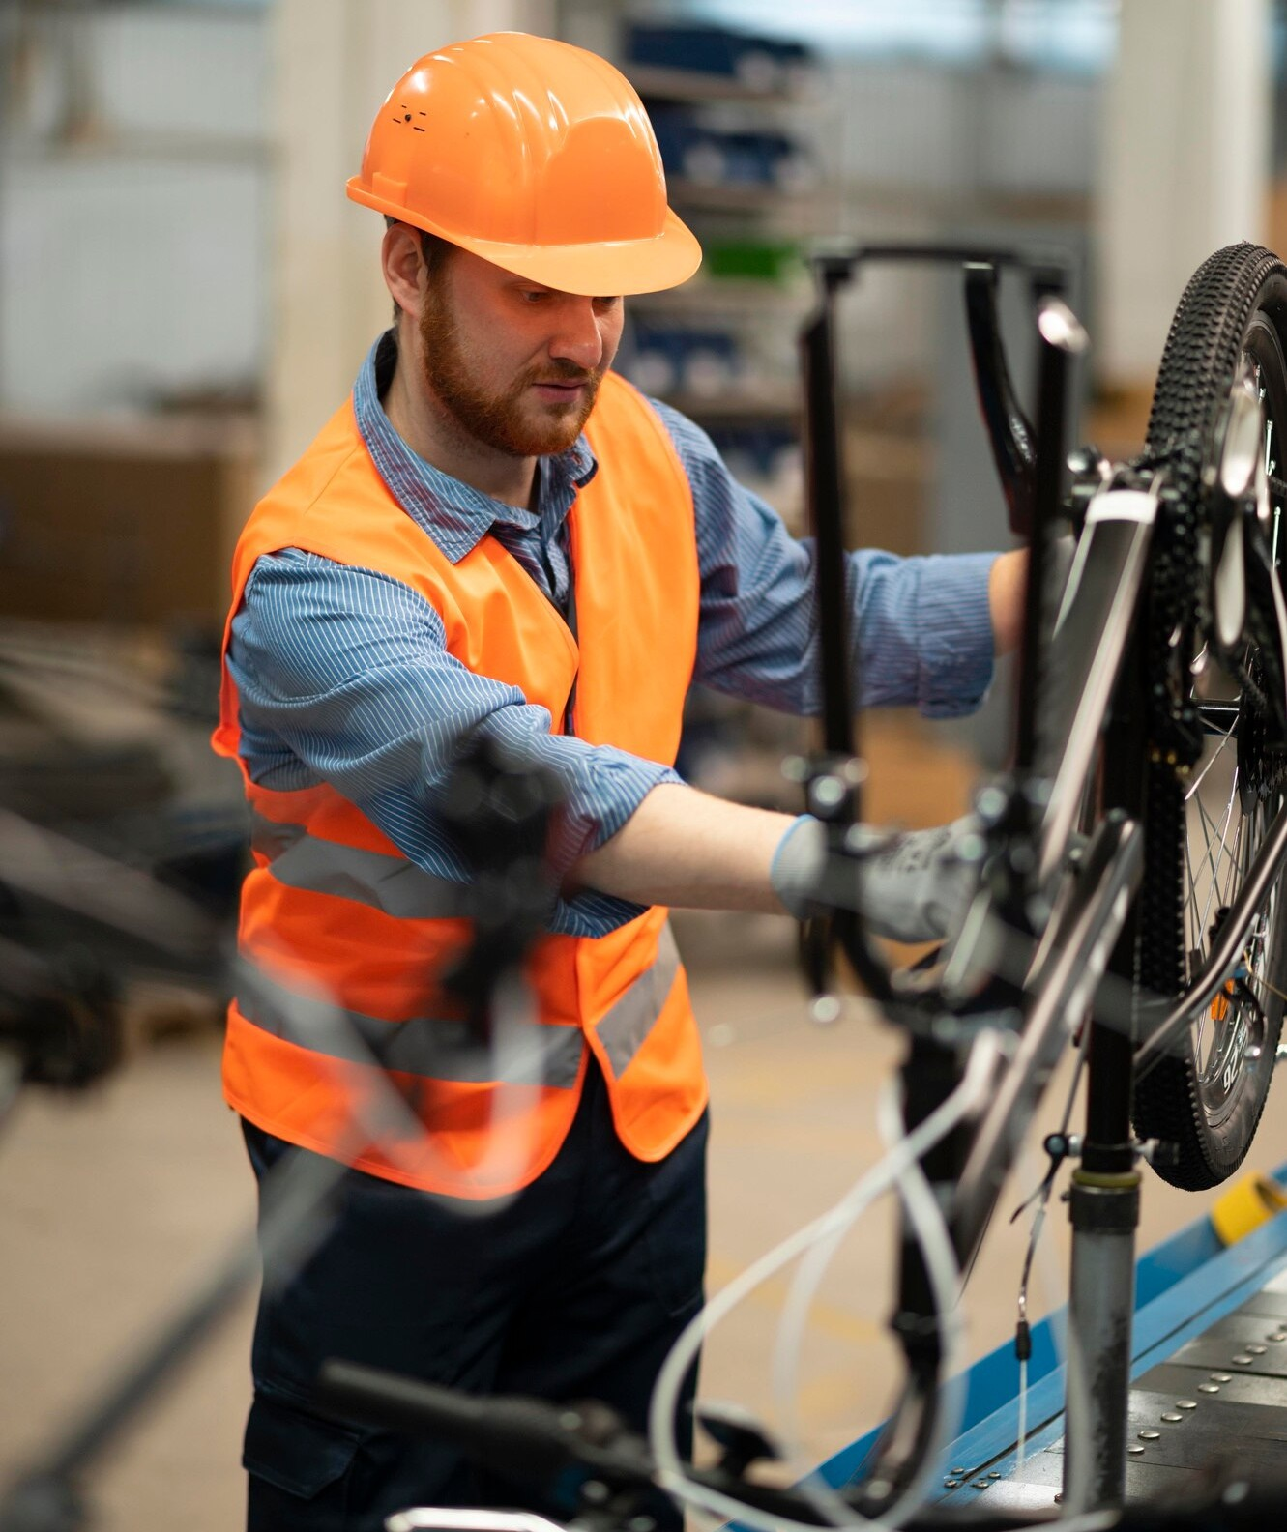




Importance of Maintenance
Regular of thruster ROVs is vital for ensuring
and
. Neglecting maintenance
, increased downtime, and
can lead to unforeseen
costly repairs. Proactive maintenance strategies can significantly enhance performance and reliability.

Slide 5
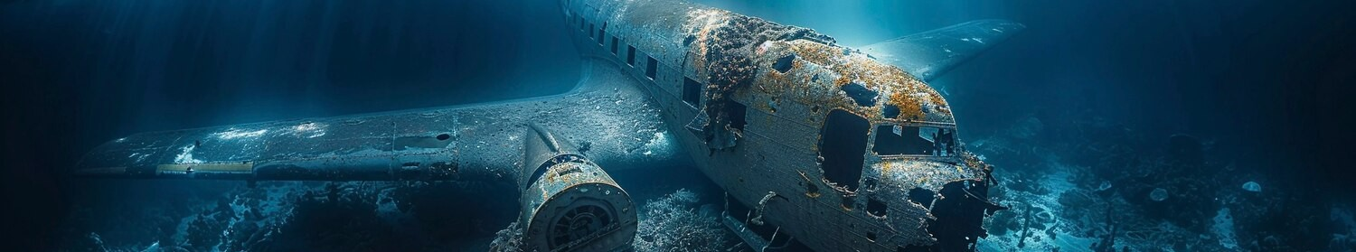


Common Issues in Thruster ROVs
Thruster | ROVs | often | face issues such as | ,
 |  |  | , and . Identifying | these | common
problems early can prevent and extend the operational life of the ROV. Understanding these issues is crucial for effective maintenance.

Slide 6

Preventive Maintenance Strategies
Implementing
ROVs. Regular inspections,
strategies is essential for thruster
, and component replacements can
help detect issues before they escalate. A well-structured maintenance schedule ensures optimal performance and minimizes unexpected failures.

Slide 7

Use of Technology in Maintenance
Incorporating such as and
can enhance maintenance processes for thruster ROVs. These tools allow for real-time monitoring and data
collection, leading to more informed decision-making and timely interventions for repairs.

Slide 8
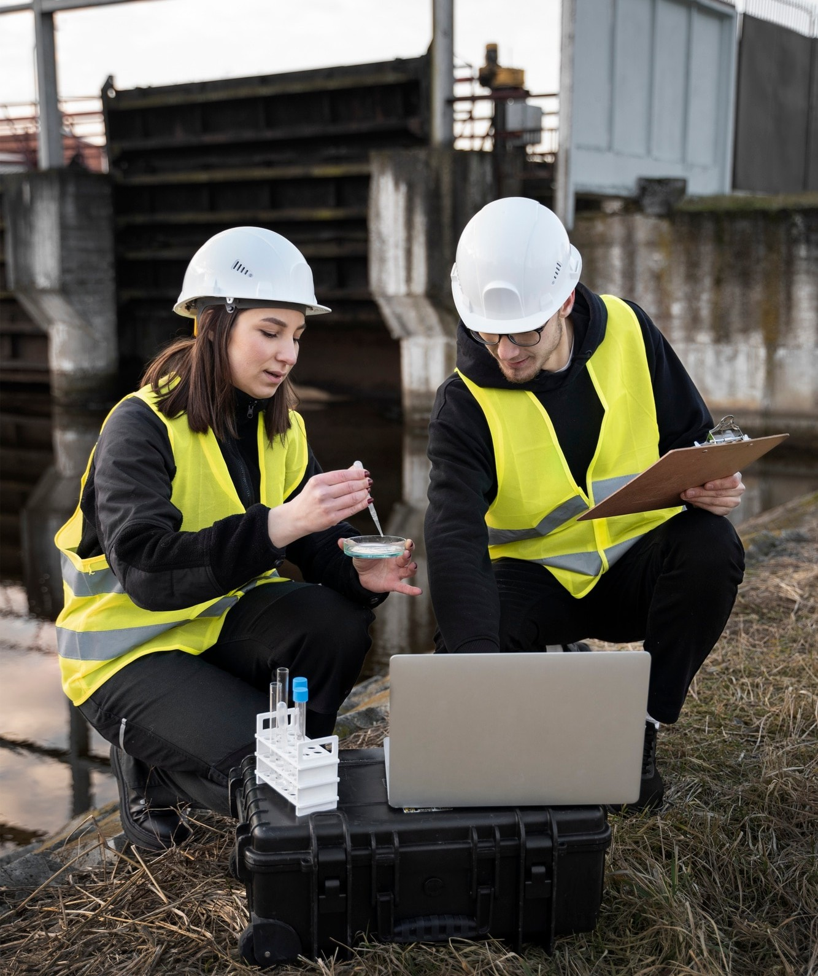
Training and Skill Development
Investing in and for maintenance personnel is crucial. A knowledgeable team can effectively troubleshoot and repair issues, ensuring that thruster ROVs remain operational and efficient. Continuous education on new technologies is also important.

Slide 9

Documentation and Reporting
Maintaining accurate of maintenance activities is essential. Detailed reports help track performance trends, identify recurring issues, and facilitate better decision-making. This practice ensures accountability and enhances the overall maintenance process.

Slide 10

Case Studies: Success Stories
Examining of successful thruster ROV maintenance can provide valuable insights. These examples highlight effective strategies and innovative solutions that have led to improved reliability and performance, serving as models for future practices.

Slide 11

Future Trends in ROV Maintenance
The future of thruster ROV maintenance is likely to be shaped by and .
Embracing these trends can lead to more efficient
processes and better performance outcomes, ensuring ROVs meet the demands of evolving underwater tasks.

Slide 12
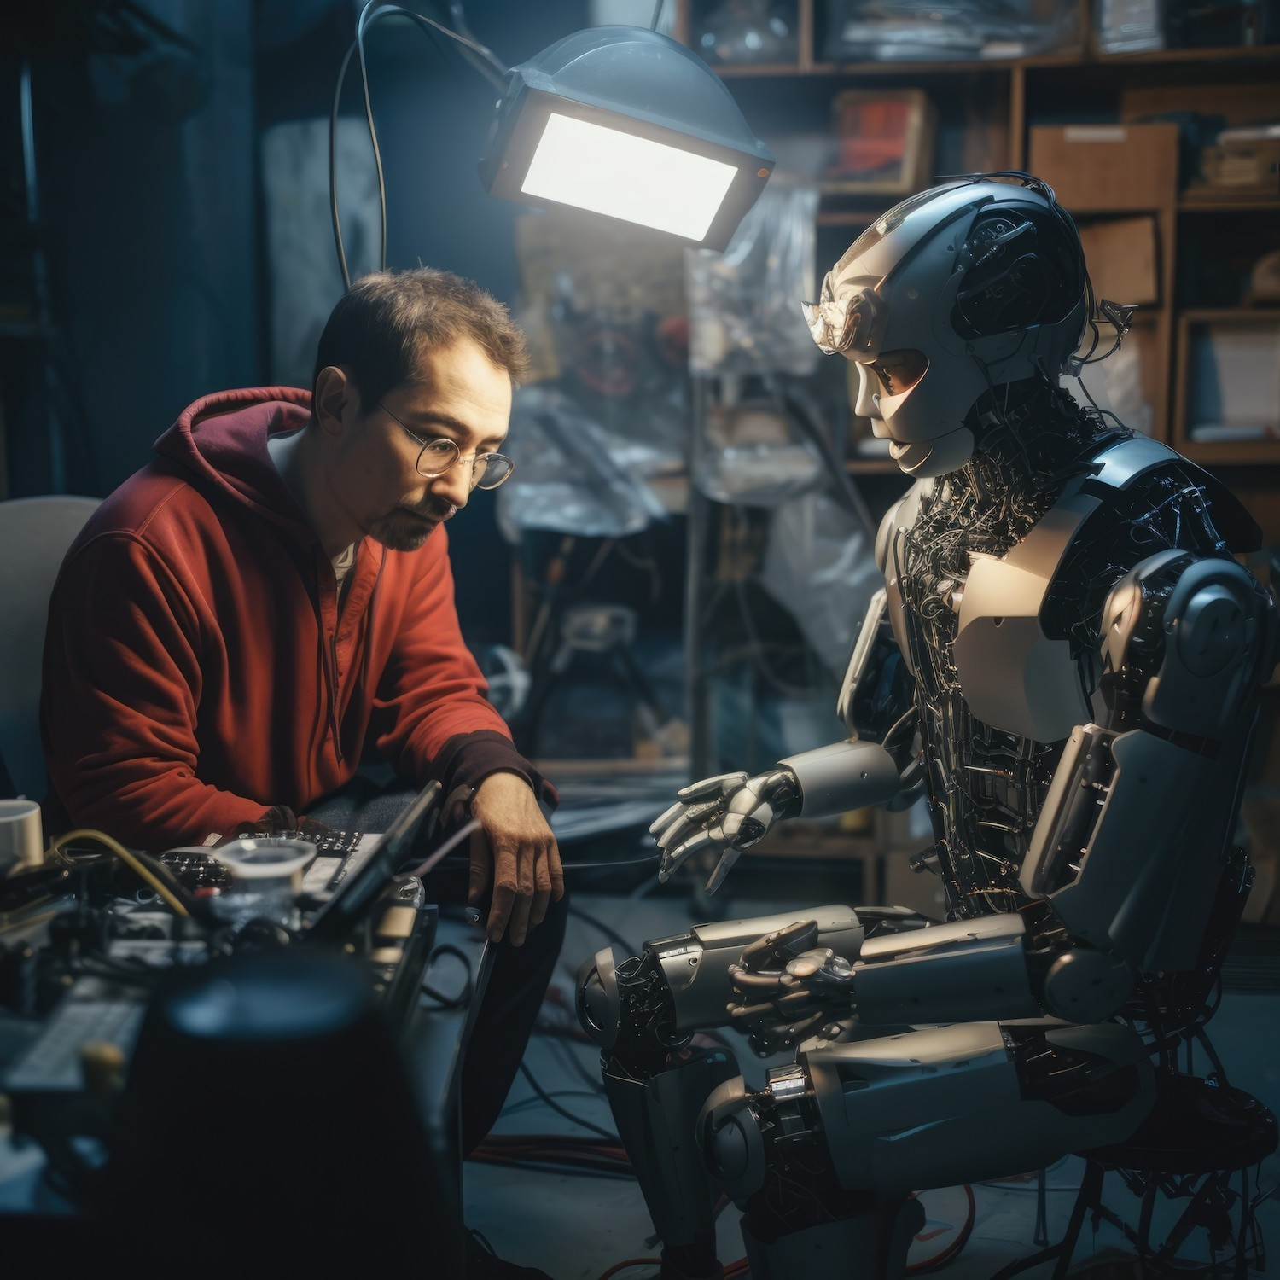





Challenges in Maintenance
Despite advancements, challenges such as
,
, and persist in thruster
ROV maintenance. Addressing these challenges requires innovative solutions and a commitment to continuous improvement in maintenance practices.

Slide 13



Conclusion and Key Takeaways
In conclusion, optimizing maintenance and repair techniques for thruster ROVs is vital for ensuring their and
significantly enhance their operational capabilities.
. By | implementing | proactive | strategies, leveraging
technology, and | investing in | training, | organizations can

Slide 14











Thanks!
Você tem alguma pergunta?
seuemail@freepik.com
+91 620 421 838
seusite.com

